Slide 1
Machine Learning Foundations

Slide 2

Piensa
Digamos que eres es un agente inmobiliario. Tu negocio está creciendo, por lo que contratas a un grupo de nuevos agentes en prácticas para que te ayuden.
Pero hay un problema: puedes echar un vistazo a una casa y tener una idea bastante buena de su valor, pero tus pupilos no tienen tu experiencia por lo que no saben cómo ponerle precio a sus casas.
Para ayudar a tus alumnos (y tal vez regalarte unas vacaciones), decides escribir una pequeña aplicación que puede estimar el valor de una casa en tu área en función de su tamaño, vecindad, etc., y qué casas similares se han vendido.
Extracto del blog de Adam Geitgey: machinelearningisfun

Slide 3
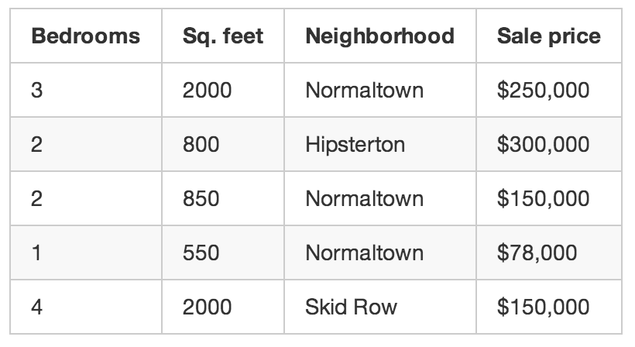
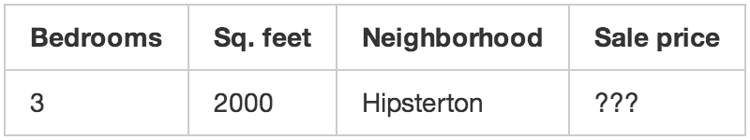
Una app para calcular precios
Datos de los últimos 3 meses
Queremos poder predecir

Slide 4
Una app para calcular precios
Diseña un algoritmo para calcular los precios

Slide 5
Una app para calcular precios
Diseña un algoritmo para calcular los precios: Con ML
Número mágicos: .841231951398213, 1231.1231231, 2.3242341421, 201.23432095 -- pesos.
def estimate_house_sales_price(num_of_bedrooms, sqft, neighborhood):
price = 0
# a little pinch of this
price += num_of_bedrooms * .841231951398213
# and a big pinch of that
price += sqft * 1231.1231231
# maybe a handful of this
price += neighborhood * 2.3242341421
# and finally, just a little extra salt for good measure
price += 201.23432095
return price

Slide 6
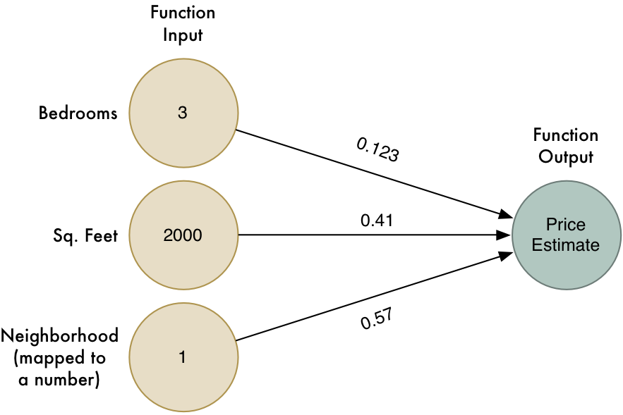
Una app para calcular precios
Algoritmo ML

Slide 7
Una app para calcular precios
Algoritmo ML
Paso 1: comienza con todos los pesos a 1
Paso 2: Ejecute todas las casas que conozcas a través de la función y mira qué tan lejos está la función de adivinar el precio correcto para cada casa:
Paso 3: Repite el paso 2 una y otra vez con cada combinación posible de pesos. Cualquiera que sea la combinación de pesos que haga la diferencia más cercana a cero es lo que usarás.
Cuando encuentres los pesos que funcionan, ¡has resuelto el problema!

Slide 8
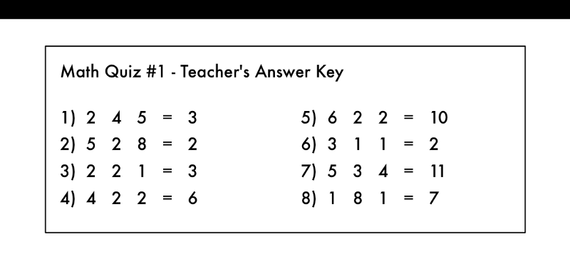
Una app para calcular precios

Slide 9
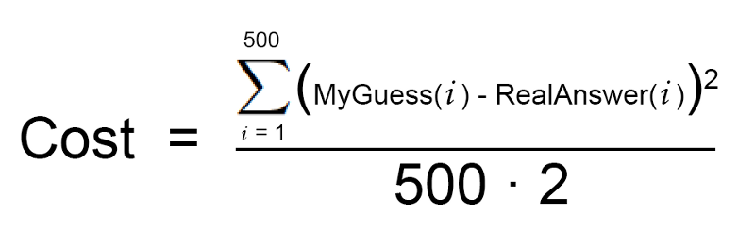
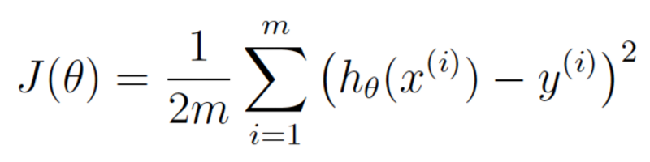
El paso 2
Una manera más lista: matemáticas
Más formalmente

Slide 10
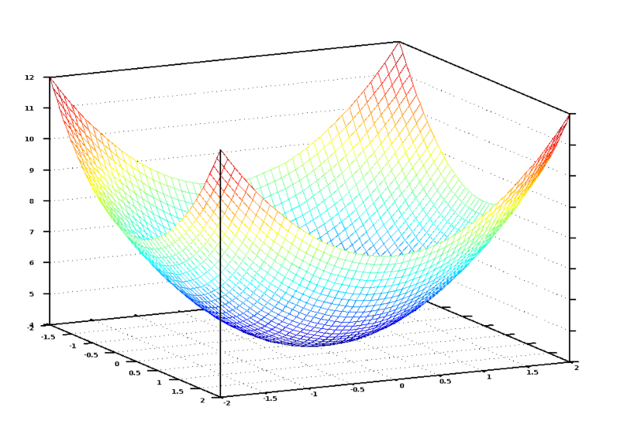
El paso 2
Una manera más lista: matemáticas

Slide 11
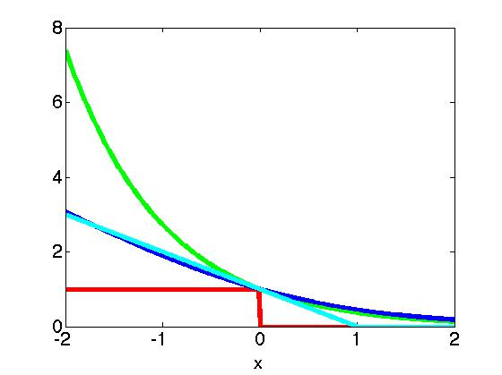

Loss Functions for Classification
(AdaBoost)
(Logistic Regression)
(SVM)
Notes:
I’m going to write this idea about the loss functions in notation on the next slide.

Slide 12
Statistical Learning Theory
Ockham’s Razor: The best models are simple models that fit the data well.
William of Ockham, English frier and philosopher (1287-1347) said that among hypotheses that predict equally well, we should choose the one with the fewest assumptions.

Slide 13
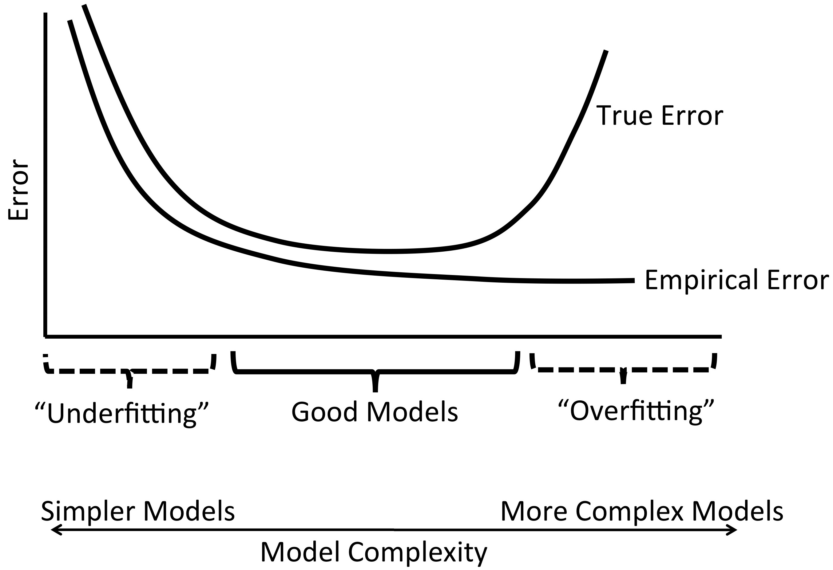
Statistical Learning Theory
Ockham’s Razor: The best models are simple models that fit the data well.
Test Error
Training Error
Notes:
True for classification, regression, etc.

Slide 14
Basic Outline for Machine Learning
Step 1: Split data randomly into training and test sets.
Step 2: Estimate coefficients / Train model:
Step 3: Score model:
Compute score for each x_{i} in the test set
Step 4: Evaluate model.
Notes:
Estimate coefficients by minimizing the negative log likelihood of the data given the model. Or if you prefer the first description, minimize the loss function.

Slide 15
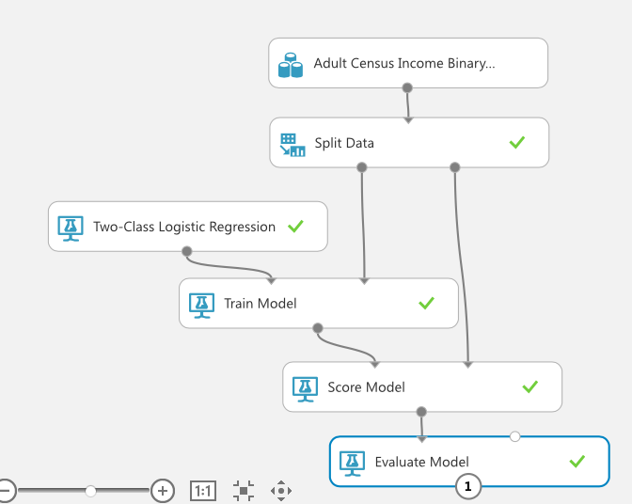
Notes:
Step 1: split it into training and test
Step 2: train the model, and we picked logistic regression for that one. Then we scored the model in step 3, and then evaluate in Step 4. And that’s a super quick and easy way to do machine learning.

Slide 16
Logistic Regression
Notes:
Where the 3 is the beta 1 and x1 is the number of hours they work per week,
We know x, we need to figure out beta. The 3 and the 4, we don’t know them in advance, we have to learn them.

Slide 17
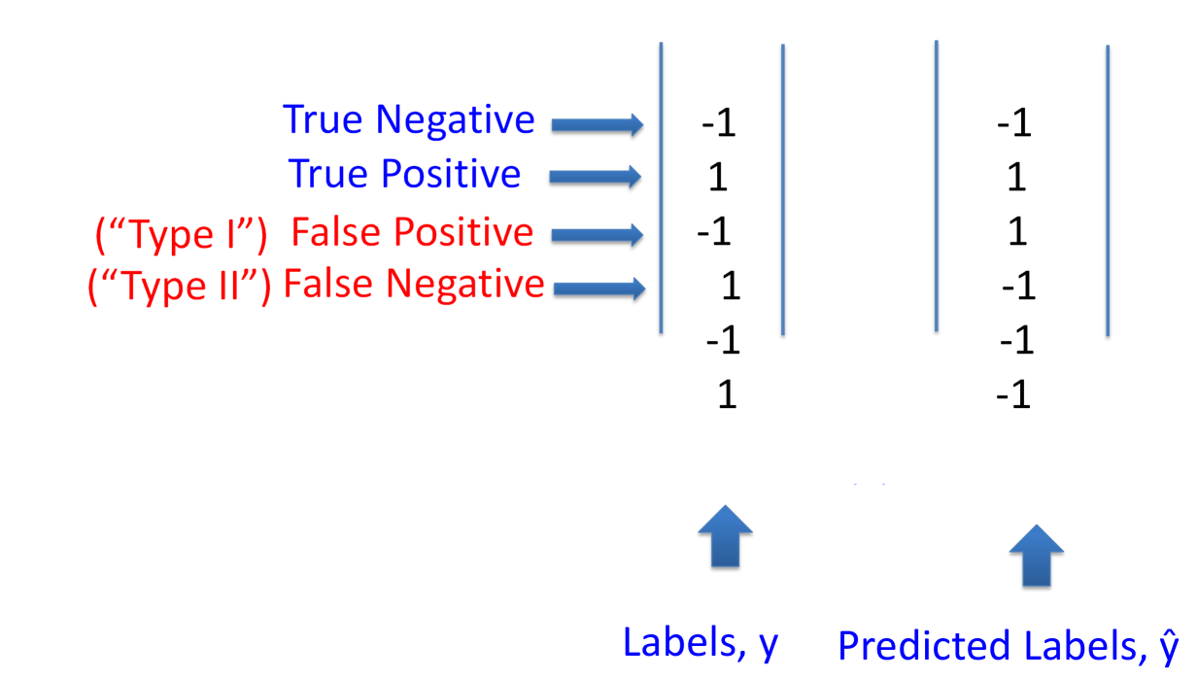
Clasificación

Slide 18
Confusion Matrix
 | y=+1 | y=-1
ŷ=1 | 723 | 15
ŷ=-1 | 72 | 409

Slide 19
Evaluation Measures for Classifiers
Misclassification error
 | y=+1 | y=-1
ŷ=1 | TP | FP
ŷ=-1 | FN | TN
Notes:
Note that this is just 1 minus accuracy. So sometimes people say they are using accuracy and they mean the misclassification error. It’s the same calculation.

Slide 20
Evaluation Measures for Classifiers
True Positive Rate (TPR), Sensitivity, Recall
 | y=+1 | y=-1
ŷ=1 | TP | FP
ŷ=-1 | FN | TN

Slide 21
Evaluation Measures for Classifiers
True Negative Rate (TNR), Specificity
 | y=+1 | y=-1
ŷ=1 | TP | FP
ŷ=-1 | FN | TN
Notes:
Note that this is just 1 minus accuracy. So sometimes people say they are using accuracy and they mean the misclassification error. It’s the same calculation.

Slide 22
Evaluation Measures for Classifiers
False Positive Rate (FPR)
 | y=+1 | y=-1
ŷ=1 | TP | FP
ŷ=-1 | FN | TN
Notes:
Note that this is just 1 minus accuracy. So sometimes people say they are using accuracy and they mean the misclassification error. It’s the same calculation.

Slide 23
Evaluation Measures for Classifiers
Precision
 | y=+1 | y=-1
ŷ=1 | TP | FP
ŷ=-1 | FN | TN
Notes:
Note that this is just 1 minus accuracy. So sometimes people say they are using accuracy and they mean the misclassification error. It’s the same calculation.

Slide 24
Evaluation Measures for Classifiers
F1-score
Precision
 | y=+1 | y=-1
ŷ=1 | TP | FP
ŷ=-1 | FN | TN
Recall
 | y=+1 | y=-1
ŷ=1 | TP | FP
ŷ=-1 | FN | TN
Notes:
It’s amazing how many different ways people commonly measure things, out of only 4 numbers. Once you have that confusion matrix, you can compute any of them that you like.

Slide 25
Information Retrieval
Precision@N para una búsqueda: De las N páginas Top recividas, cuantas son relavantes?
Recall@N para una búsqueda: Si hay NN=#Pos páginas relavantes, qué fracción devolvió la búsqueda?

Slide 26
ROC Curves
For a particular False Positive Rate (FPR), what is the True Positive Rate (TPR)?
1
TPR
ROC curve
0
FPR
0
1

Slide 27
ROC Curves
For a particular False Positive Rate (FPR), what is the True Positive Rate (TPR)?
1
TPR
AUC/AUROC
0
FPR
0
1

Slide 28
ROC Curves
For a particular False Positive Rate (FPR), what is the True Positive Rate (TPR)?
1
Mejor que esto: aleatorio
TPR
0
FPR
0
1
Notes:
If you’re not better than that line, you might want to turn your classifier upside down so it predicts the opposite of what it’s currently doing. Because it’s worse than random guessing, which means it could be better if you flipped it. Hopefully you’ll get a curve like I showed you on the previous slide. Most of the time you don’t get perfect. Most prediction problems are not that easy.

Slide 29
Evaluación
Muchas maneras de evaluar un modelo:
Confusion matrix (TP, TN, FP, FN)
Accuracy / misclassification error
Precision, Recall, F1-score
ROC curves, AUC/AUROC
Notes:
Including all of the ways we enumerated in the data science course.

Slide 30
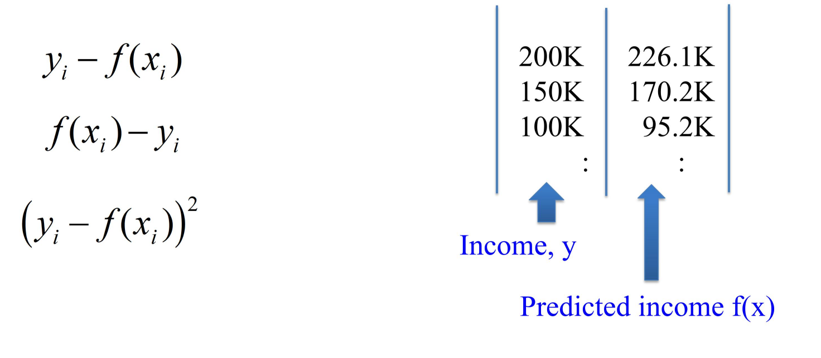
Regresión
Menor error al cuadrado
Notes:
Including all of the ways we enumerated in the data science course.

Slide 31
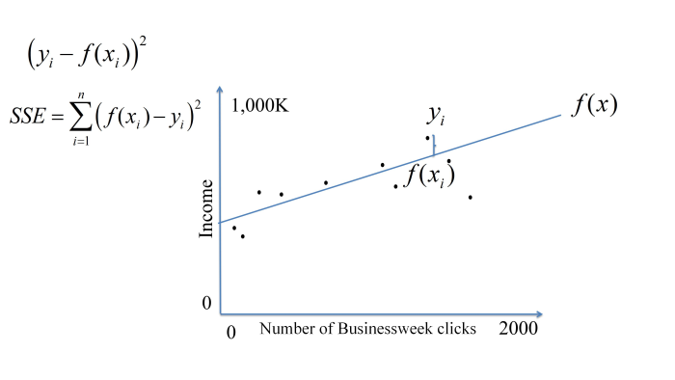
Regresión
Menor error al cuadrado
Notes:
Including all of the ways we enumerated in the data science course.

Slide 32
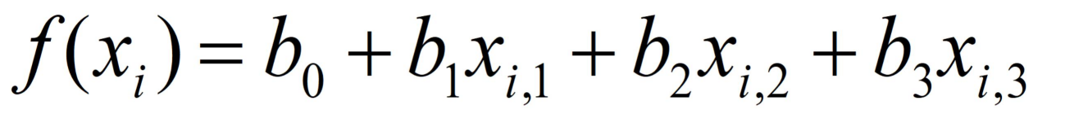
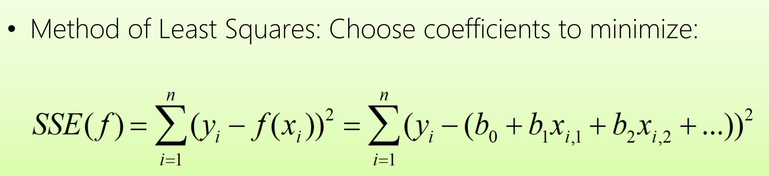
Regresión
Modelo lineal
Suma de menores cuadrados
Notes:
Including all of the ways we enumerated in the data science course.

Slide 33
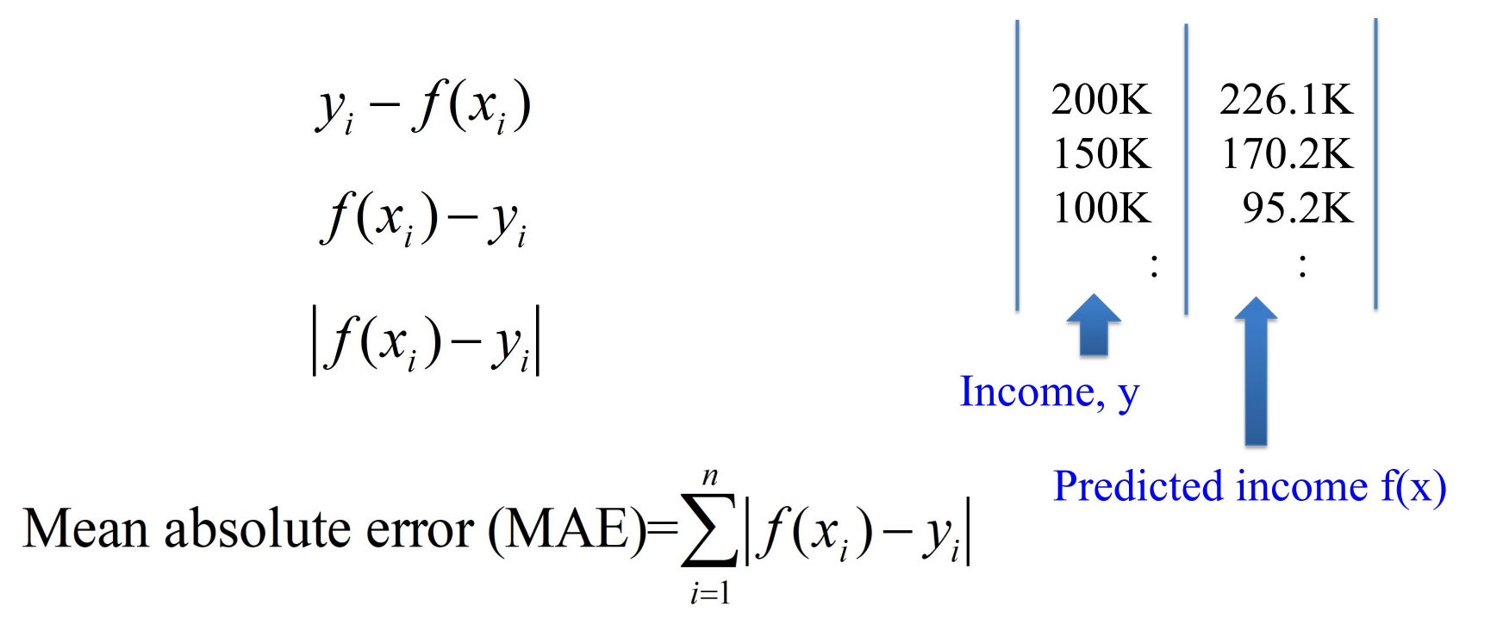
Evaluar Regresión
Error medio absoluto
Notes:
Including all of the ways we enumerated in the data science course.

Slide 34
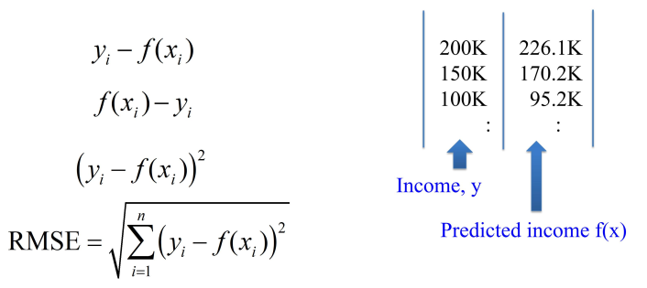
Evaluar Regresión
Raiz cuadrada del Error medio
Notes:
Including all of the ways we enumerated in the data science course.

Slide 35
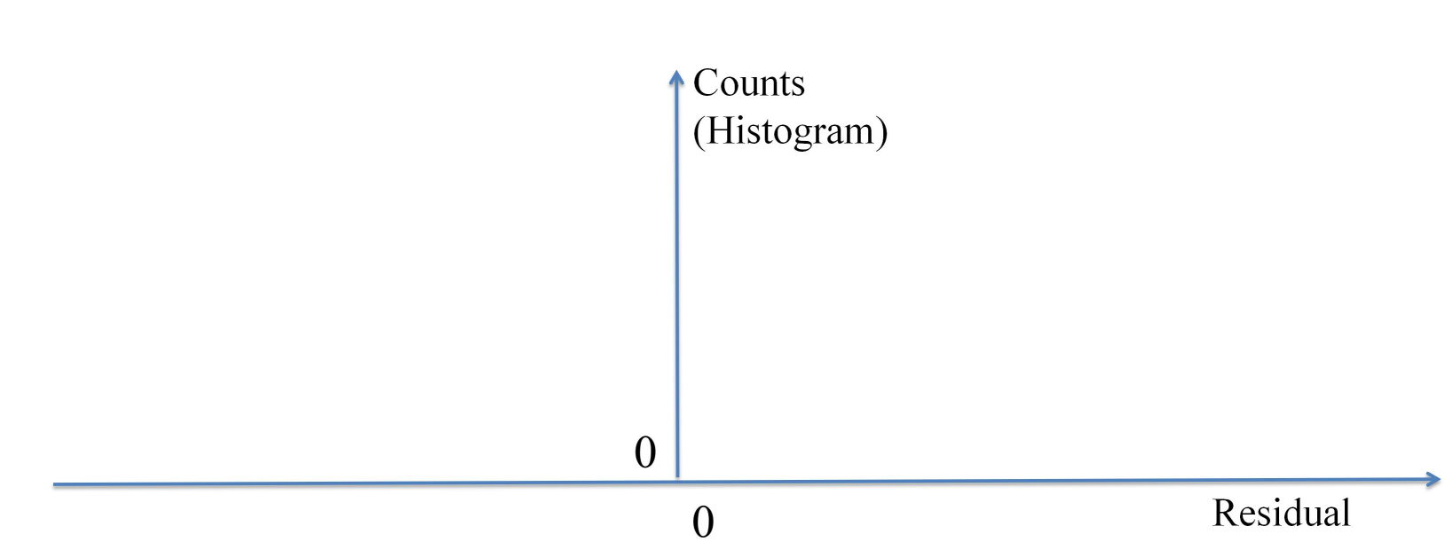
Evaluar Regresión
Residuos
Queremos que estén lo más cerca a cero
Notes:
Including all of the ways we enumerated in the data science course.

Slide 36
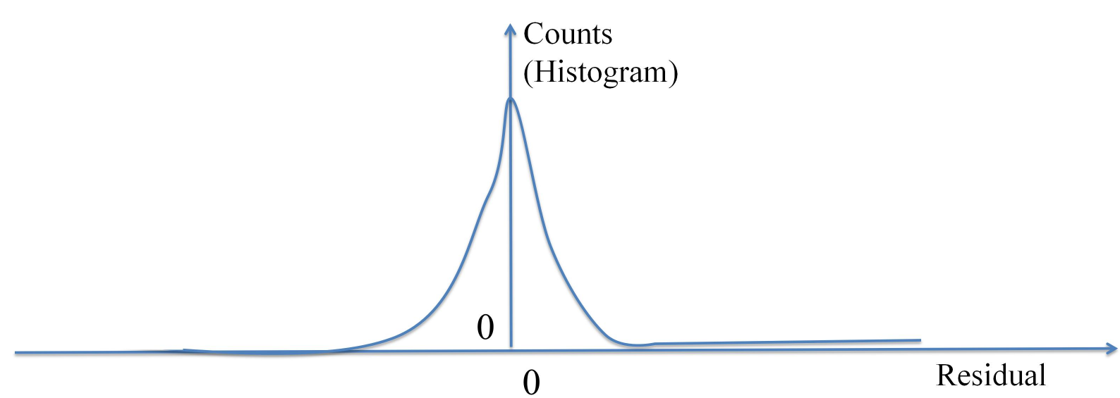
Evaluar Regresión
Residuos
Queremos que estén lo más cerca a cero
Notes:
Including all of the ways we enumerated in the data science course.

Slide 37
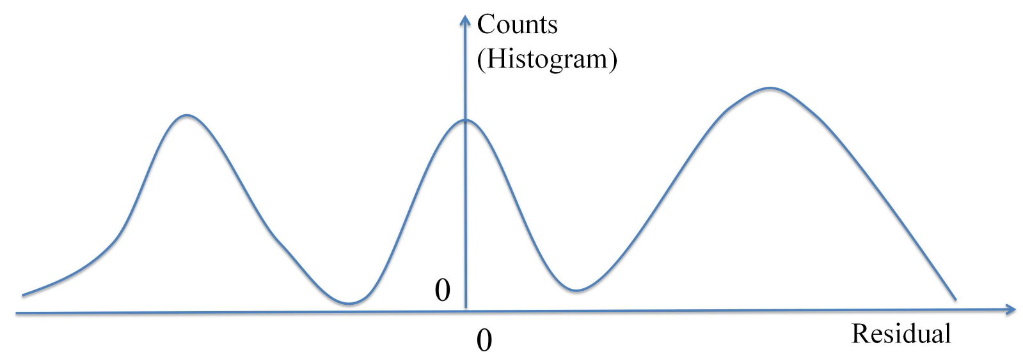
Evaluar Regresión
Residuos
Queremos que estén lo más cerca a cero
Notes:
Including all of the ways we enumerated in the data science course.

Slide 38
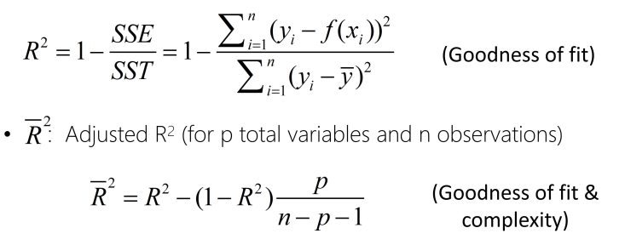
Evaluar el fitness y la complejidad
R2 y R2 Ajustado
Notes:
Including all of the ways we enumerated in the data science course.

Slide 39
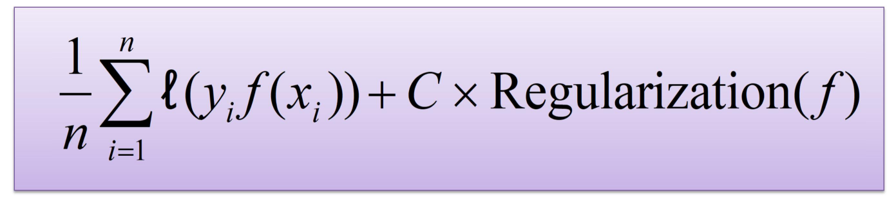
Regularización
Mantener el modelo simple
Notes:
Including all of the ways we enumerated in the data science course.

Slide 40
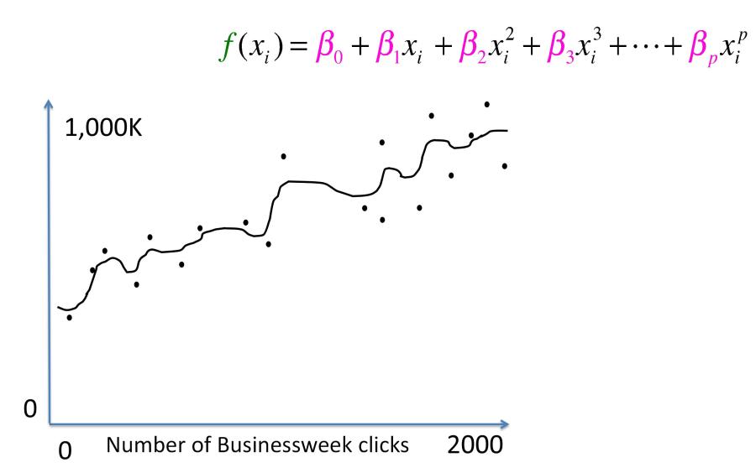
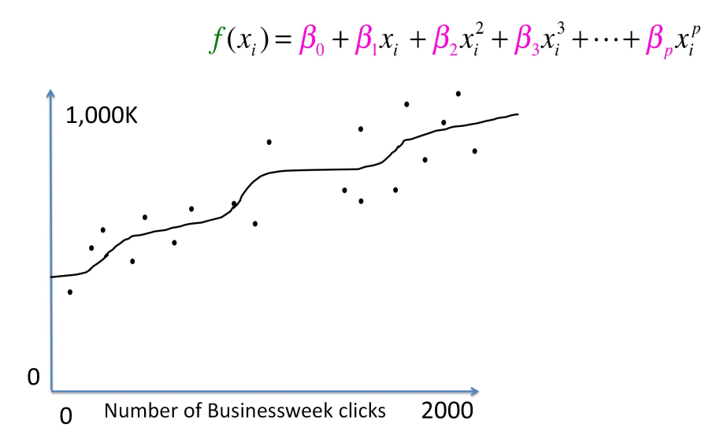
Regularización
Mantener el modelo simple
Notes:
Including all of the ways we enumerated in the data science course.

Slide 41
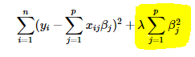
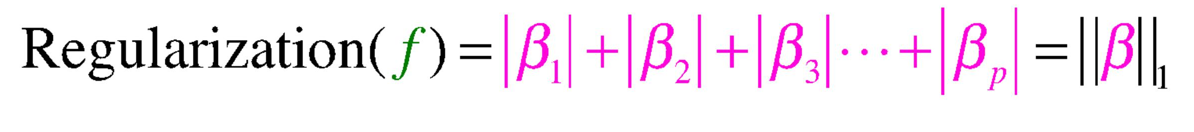
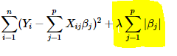
Regularización
L2 hace todos los coeficientes más pequeños -- Ridge
Función de pérdida (loss):
L1 es útil para soluciones dispersas/poco densas -- Lasso
Función de pérdida (loss):
Notes:
Including all of the ways we enumerated in the data science course.

Slide 42
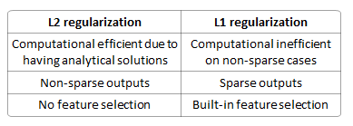
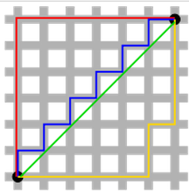
Regularización
L1 vs L2
Unicidad de la solución
Notes:
Including all of the ways we enumerated in the data science course.

Slide 43
Regularización
L1 vs L2
Robustness: L1 > L2
Robustness is defined as resistance to outliers in a dataset. The more able a model is to ignore extreme values in the data, the more robust it is.
The L1 norm is more robust than the L2 norm, for fairly obvious reasons: the L2 norm squares values, so it increases the cost of outliers exponentially; the L1 norm only takes the absolute value, so it considers them linearly.
Stability: L2 > L1
Stability is defined as resistance to horizontal adjustments. This is the perpendicular opposite of robustness.
The L2 norm is more stable than the L1 norm. A later notebook will explore why.
Notes:
Including all of the ways we enumerated in the data science course.

Slide 44
Regularización
L1 vs L2
Computational difficulty: L2 > L1
L2 has a closed form solution because it's a square of a thing.
Sparsity: L1 > L2
Sparsity is the property of having coefficients which are highly significant: very near 0 or very not near 0. In theory, the coefficients very near 0 can later be eliminated.
Notes:
Including all of the ways we enumerated in the data science course.

Slide 45
Collinear features
Features colineares o altamente correlacionadas
Se suelen crear para obtener más información sobre topics importantes
Ensucian la interpretación de los coeficientes
Notes:
Including all of the ways we enumerated in the data science course.

Slide 46
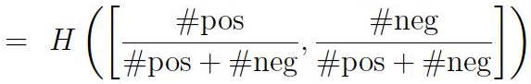
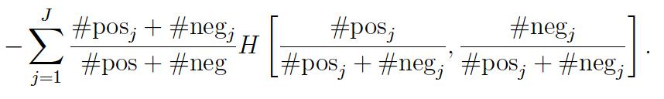
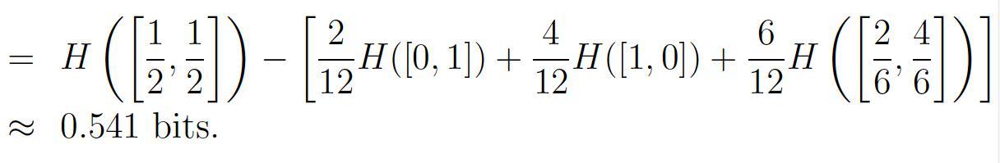
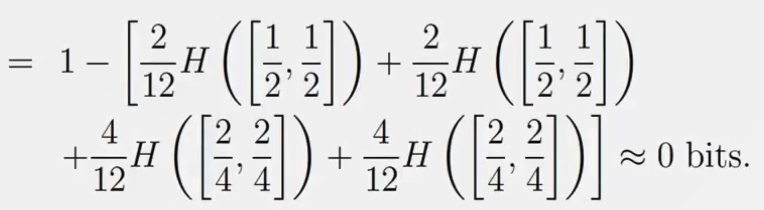
Ganancia de una rama en árboles = impureza
Gain(S,A) = la reducción esperada en la entropía debida a la división del atributo A
= entropía original - entropía después de la división
Ejemplos:
Gain(S, Guests)
Gain(S, Genre)
Notes:
Including all of the ways we enumerated in the data science course.

Slide 47
Criterio de poda de los árboles de decisón
Mínima complejidad de coste
cada sub-árbol es asignado un coste --> Escoge el sub-árbol con menor coste
Misclassification
Error
Regularization
Notes:
Including all of the ways we enumerated in the data science course.

Slide 48
Weak classifiers usados por Viola and Jones
Sustraer las áreas blancas de las negras

Slide 49
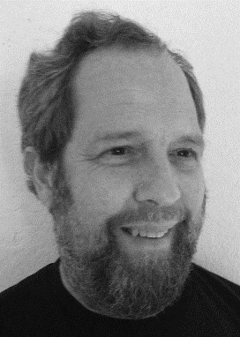
Weak classifiers usados por Viola and Jones
Sustraer las áreas blancas de las negras
Notes:
Steve elston

Slide 50
Weak classifiers usados por Viola and Jones
Sustraer las áreas blancas de las negras
No detecta nada
Blanco y negro son similares
Notes:
Steve elston

Slide 51
Weak classifiers usados por Viola and Jones
Sustraer las áreas blancas de las negras
No detecta nada
Blanco y negro son similares
Notes:
Steve elston

Slide 52
Weak classifiers usados por Viola and Jones
Sustraer las áreas blancas de las negras
Detecta diferencia!
Notes:
Steve elston

Slide 53
Weak classifiers usados por Viola and Jones
Sustraer las áreas blancas de las negras
Weak classifiers
Detecta ojos!
Notes:
But check it out. If you put that first little weak classifier right there, the answer will be big! Because there’s a huge difference between the white area, which is lighter, and the black area, which is darker. The detector is looking for the difference between the dark eyes and the part of the face below that. And the second little detector there is looking for two black areas separated by a white area, which is the person’s nose. Now each of these little detectors by itself… not so useful. Put them together, really useful. Now you can detect eyes above cheeks, you can get the space between the eyes, and so on.

Slide 54
Weak classifiers usados por Viola and Jones
Sustraer las áreas blancas de las negras
Weak classifiers
Detecta ojos, nariz
Notes:
But check it out. If you put that first little weak classifier right there, the answer will be big! Because there’s a huge difference between the white area, which is lighter, and the black area, which is darker. The detector is looking for the difference between the dark eyes and the part of the face below that. And the second little detector there is looking for two black areas separated by a white area, which is the person’s nose. Now each of these little detectors by itself… not so useful. Put them together, really useful. Now you can detect eyes above cheeks, you can get the space between the eyes, and so on.
The eye region is darker than the upper-cheeks.
The nose bridge region is brighter than the eyes.

Slide 55


Weak classifiers usados por Viola and Jones
Usa cientos de miles de estos weak classifiers en diferentes escalas
Notes:
Because of course faces can be large in an image or they can be small. Now these are all *weak* classifiers since obviously none of them are really that much better than random guessing, but they are, in fact, better than random, which means if you combine them, you could get something really good.

Slide 56
Weak classifiers usados por Viola and Jones
Usa cientos de miles de estos weak classifiers en diferentes escalas
Notes:
And obviously the goal is to put these little boxes around people’s faces.

Slide 57
Pseudocódigo de AdaBoost
Asignar a la observación i el peso d_{1i}=1/n (pesos iguales).
Para t=1:T
Entrenar el weak learning algorithm usando los datos ponderados por d_{ti}=1/n. Esto produce un weak classifier h_{t}.
Escoger el coeficiente α_{t}.
Actualizar pesos:
Z_{t} es un factor normalizador
Final
Salida del clasificador final:
Notes:
https://www.cs.princeton.edu/courses/archive/spring07/cos424/papers/boosting-survey.pdf
I’ll tell you how to get the alpha’s later on.
The effect of the weight update is that it increases the weights on the misclassified points and decreases the weights on the correctly classified points.

Slide 58
Ejemplo de Boosting
All points start with equal weights.
(Credit: Example adapted from Freund and Schapire)
Notes:
Our weak classifiers are only allowed to be lines that are either horizontal or vertical in this example.

Slide 59
Ejemplo de Boosting
Run the weak learning algorithm to get a weak classifier.
alpha depends on missclassfication
(Credit: Example adapted from Freund and Schapire)
Notes:
Ok which points were misclassified? The three up there.

Slide 60
Ejemplo de Boosting
Increase the weights on the misclassified points, decrease the weights on the correctly classified points.
(Credit: Example adapted from Freund and Schapire)
Notes:
So it basically has to get those three points right on the next round.
Before I do the next round, I have to choose the coefficient for this weak classifier, which is going to determine how much it contributes to the final combined classifier. I will tell you how to get it shortly officially, but I’ll tell you now that the weight depends on how well the weak classifier performs on that round. So here, the weak classifier missed three points that had reasonable weights, so it won’t get a high coefficient.
So let’s do the next round.

Slide 61
Ejemplo de Boosting
(Credit: Example adapted from Freund and Schapire)
Notes:
So it basically has to get those three points right on the next round. So let’s do the next round.

Slide 62
Ejemplo de Boosting
Run the weak learning algorithm to get a weak classifier for the weighted data.
(Credit: Example adapted from Freund and Schapire)
Notes:
Yes it gets those points right this time, but it sacrifices the three negative ones below it.

Slide 63
Ejemplo de Boosting
Increase the weights on the misclassified points, decrease the weights on the correctly classified points.
(Credit: Example adapted from Freund and Schapire)
Notes:
See this time the coefficient is higher because it got those three positives right that had high weights.

Slide 64
Ejemplo de Boosting
Increase the weights on the misclassified points, decrease the weights on the correctly classified points.
(Credit: Example adapted from Freund and Schapire)
Notes:
Let’s see what it does now.

Slide 65
Ejemplo de Boosting
Increase the weights on the misclassified points, decrease the weights on the correctly classified points.
(Credit: Example adapted from Freund and Schapire)
Notes:
Now it got all the high weighted points correct so this classifier gets to contribute a lot to the final combined one.

Slide 66
Ejemplo de Boosting
H=sign(.42 + .66 + .93 )
(Credit: Example adapted from Freund and Schapire)

Slide 67
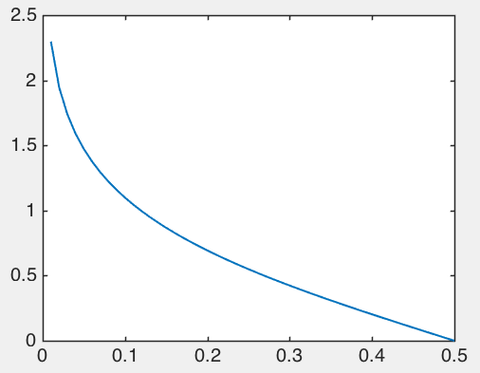
Actualización de coeficientes de AdaBoost

Slide 68
Decision Forests
Herramienta de predicción compleja y poderosa
Caja negra
Utiliza una idea similar a los boosted decision trees: si se promedian muchos modelos correlacionados precisos, se reduce la varianza.
Notes:
Leading to better generalization. Let’s say you want to know whether you should get surgery. You ask your doctor, and she says you should get it. Do you trust that? Even if the doctor is good you might not trust that one doctor. What if instead you could ask 10 equally good doctors all trained at different places and 8 of them said you should get it. Perhaps that’s much more trustworthy than just asking the one doctor. That’s the idea behind decision forests.

Slide 69
Decision Forests: pseudocódigo
For t=1 to T:
Draw a bootstrap sample of size n from the training data.
Grow a tree (tree_{t}) using this splitting and stopping procedure:
Choose m features at random (out of p)
Evaluate the splitting criteria on all of them
Split on the best feature
If the node has less than n_{min} then stop splitting.
Output all the trees.
To predict on a new observation x, use the majority vote of the trees on x.

Slide 70
Decision Forests for Regression: pseudocódigo
For t=1 to T:
Draw a bootstrap sample of size n from the training data.
Grow a tree (tree_{t}) using this splitting and stopping procedure:
Choose m features at random (out of p)
Evaluate the splitting criteria on all of them
Split on the best feature
If the node has less than n_{min} then stop splitting.
Output all the trees.
To predict on a new observation x, use the average vote of the trees on x.

Slide 71
Decision Forests for Regression: pseudocódigo
Ventajas
Herramienta de predicción compleja y poderosa, altamente no lineal
Desventajas
Caja negra
Tiende al over fit a menos que se ajuste con cuidado
Lento
Notes:
I think RF is pretty neat. You grow a whole bunch of totally overfitted heuristic models and average their votes all together. How cool is that?

Slide 72
Diferencia entre Boosted Decision Trees y Decision Forests
Decision Forests
calcular muchos árboles de diferentes subconjuntos de datos y características
Los promedia (bagging).
Boosted Decision Trees
re-pondera los datos para generar distintos árboles
La combinación minimiza el training error
Notes:
They have very different sorts of philosophies even though what you end up with at the end is pretty similar, which is a bunch of overfitted heuristic trees, combined in some way. The philosophy behind decision forests is to average everything to reduce variance. The approach behind boosting tries to minimize bias and make the model more accurate, but ends up reducing variance anyway because the trees that it generates tend to be diverse because of all the reweighting. Anyway, I would say those are two of the most powerful black box machines learning methods out there right now.

Slide 73
Propagación del error en las redes neuronales

Slide 74
Propagación del error en las redes neuronales

Slide 75
Propagación del error en las redes neuronales
’s
The L are forward. We must have already computed all the ‘s ahead of us to compute this.

Slide 76
Propagación del error en las redes neuronales
o₁

Slide 77
Backpropagation
Sabemos como computar para todos los
El decenso de gradiente
α está entre 0 Y 1. Es el “learning rate”.
De esta manera se hace el backpropagation
Cómo se hace el forward prop?
Notes:
In standard backprop, too low a learning rate makes the network learn very slowly. Too high a learning rate makes the weights and objective function diverge, so there is no learning at all. You could set it to a half. In reality there are algorithms that adjust this thing dynamically, but in case, hopefully you get the idea, which is that the weight changes depending on how steep the error gradient is at that point.
Cool, so once you do that,

Slide 78
Kernels for SVM
The “kernel trick” allows the SVM to map all points to a high dimensional space where points are more easily separated.
Notes:
But the picture is a little misleading since you never actually see the function phi.

Slide 79
Kernels for SVM
minimizar , de tal manera que
−
−
+
Support Vectors
+
+
+
+
−
+
−
−

Slide 80
Kernels for SVM
SVM tiene una propiedad epecial:
Sólo depende de xi a través de productos internos
Los únicos términos de x_{i} son Inner Product(x_{i} x_{k}).
Además la formulación dice que para computar el Inner Product(x_{i} x_{k}), simplemente tienes que reemplazarlo por su función de mapeo ϕ(xi)
Lo mágico es que ...Nunca necesitaremos computar ϕ(xi)
Simplemente reemplazamos Inner Product(xi xk) por Inner Product(ϕ(xi), ϕ(xk))

Slide 81
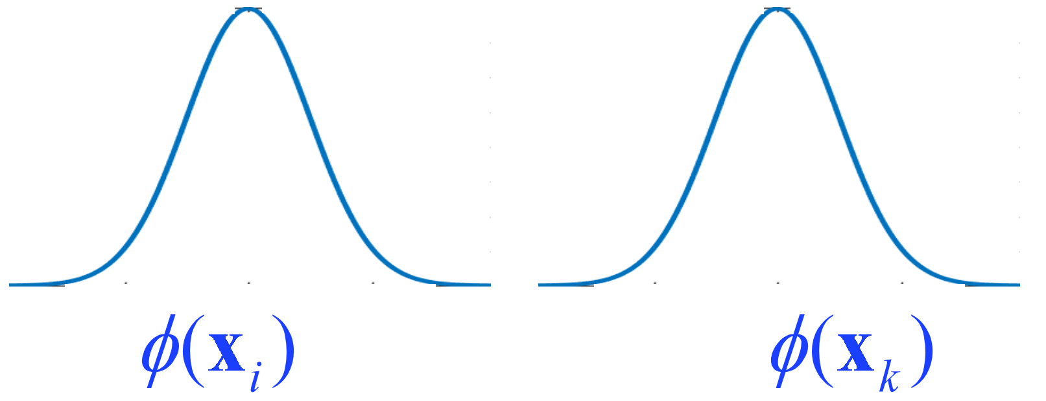
Kernels for SVM
= K(x_{i} x_{k})
Inner Product(x_{i} x_{k}) ➔Inner Product(ϕ(x_{i}), ϕ(x_{k}))
Notes:
One particularly useful kernel is the gaussian kernel. This is a case where I can’t exactly calculate phi on my computer because it’s a whole function and thus infinite dimensional. You’d need an infinite number of values to write out the whole function so of course you can’t do that in a computer. But you can actually write down the inner product.

Slide 82
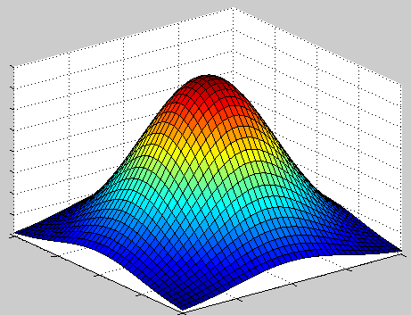
Gaussian / Radial Basis Function (RBF) Kernels
Notes:
Some of the bumps could be right side up and some of them could be upside down, depending on what the alphas are.

Slide 83
Gaussian / Radial Basis Function (RBF) Kernels
+
+
+
+
−
+
−
+
+
−
−
+
−

Slide 84
+
+
+
−
+
−
+
+
−
+
−
−
+
Notes:
You have to be careful not to choose the bandwidth parameter to be too small. Otherwise it’ll overfit.

Slide 85
+
+
+
−
+
−
+
+
−
+
−
−
+
Notes:
It’ll sort of snake its way around to try to make things separable and it’ll overfit.

Slide 86
Kernels comunes
Lineal (igual a “no kernel”)
Polinomial, se escoge el grado polinómico (demasiado alto hará over fit).
Gausiano, se escoge el ancho de banda (muy pequeño hará over fit).

Slide 87
Unsupervised Learning
“Unsupervised” significa que los datos de entrenamiento no tienen una “base de verdad” en labels de las que aprender.
Unsupervised:

Slide 88
Unsupervised Learning
“Unsupervised” significa que los datos de entrenamiento no tienen una “base de verdad” en labels de las que aprender.
Unsupervised:

Slide 89
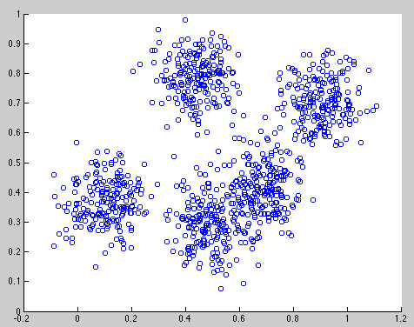
K-Means en acción
Input number of clusters, randomly initialize centers
Assign all points to the closest cluster center
Change cluster centers to be in the middle of its points
Repeat until convergence

Slide 90
K-Means en acción
Input number of clusters, randomly initialize centers
Assign all points to the closest cluster center
Change cluster centers to be in the middle of its points
Repeat until convergence

Slide 91
K-Means en acción
Input number of clusters, randomly initialize centers
Assign all points to the closest cluster center
Change cluster centers to be in the middle of its points
Repeat until convergence
Notes:
This induces what’s called a voronoi partition of the space.

Slide 92
K-Means en acción
Input number of clusters, randomly initialize centers
Assign all points to the closest cluster center
Change cluster centers to be in the middle of its points
Repeat until convergence

Slide 93
K-Means en acción
Input number of clusters, randomly initialize centers
Assign all points to the closest cluster center
Change cluster centers to be in the middle of its points
Repeat until convergence

Slide 94
Listo para verlo?

Slide 95
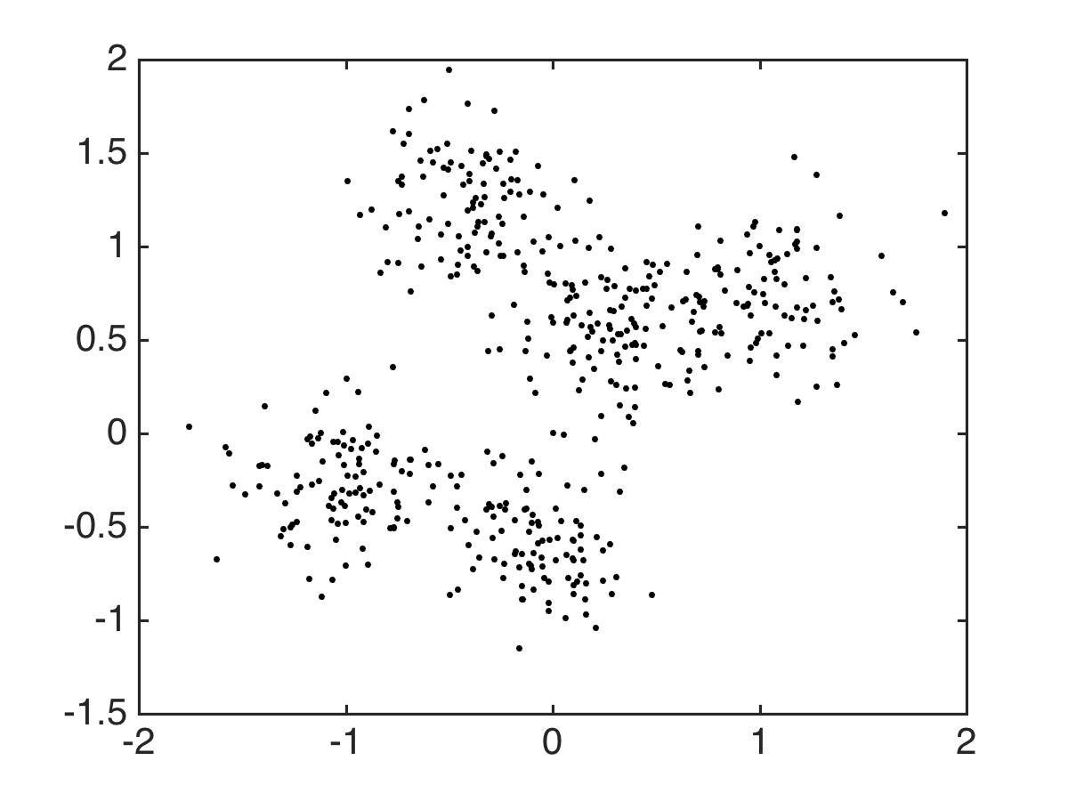

Slide 96
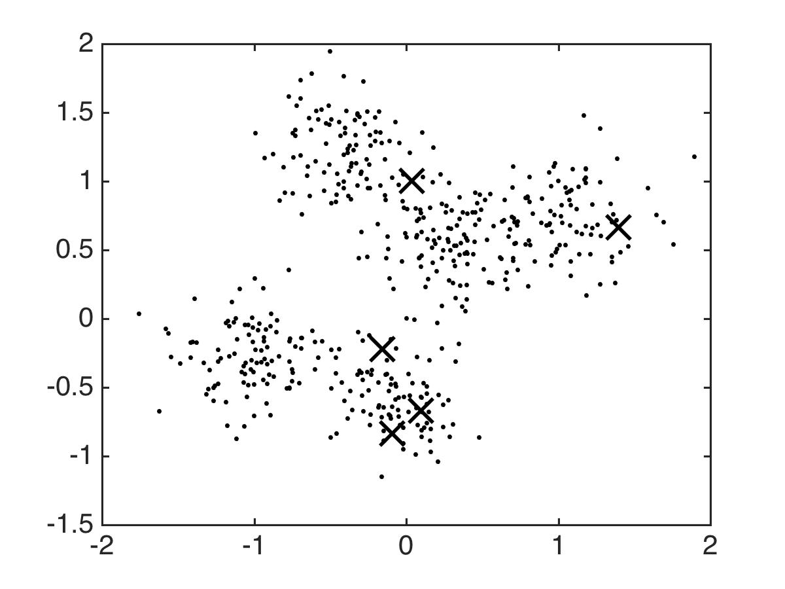
Notes:
So all these guys on the left, who are they going to get assigned to? Where will that center go?

Slide 97
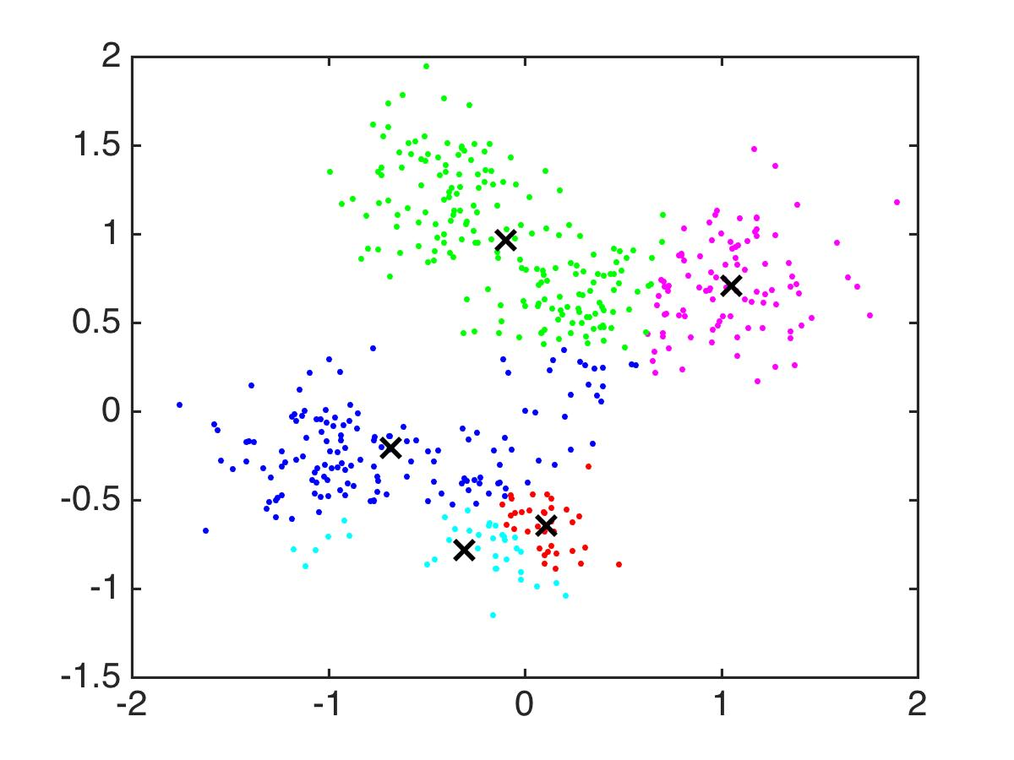

Slide 98
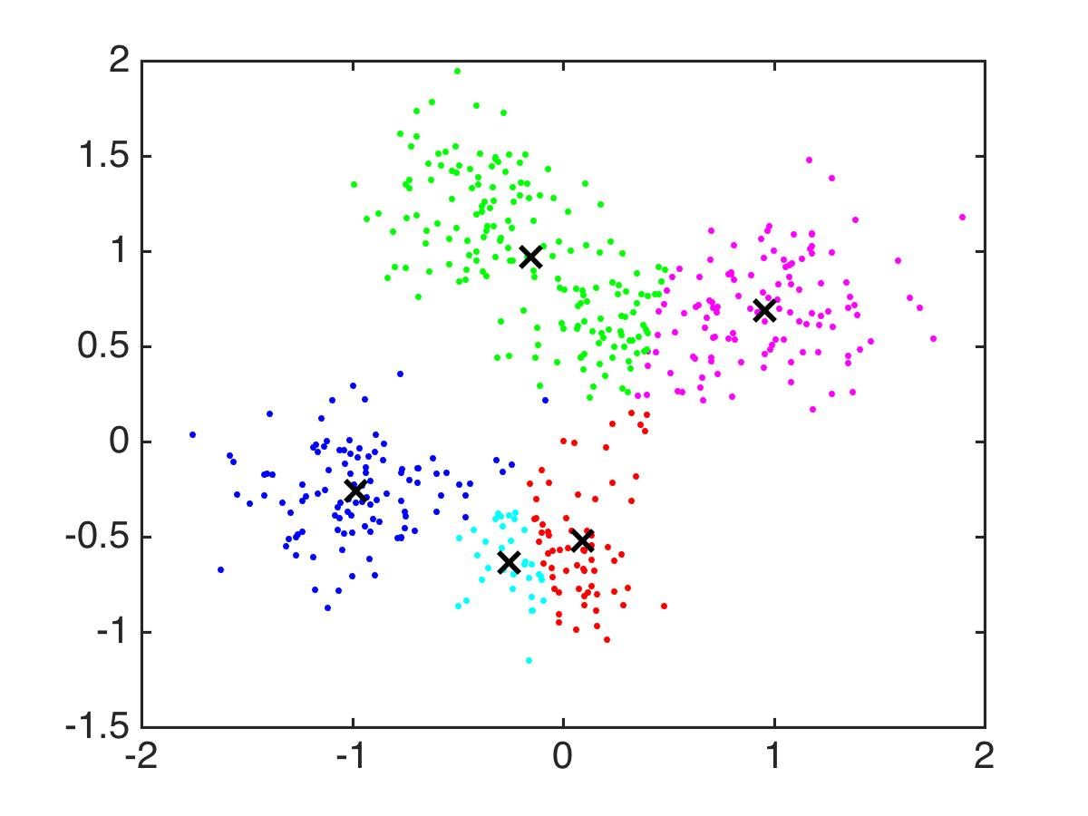

Slide 99
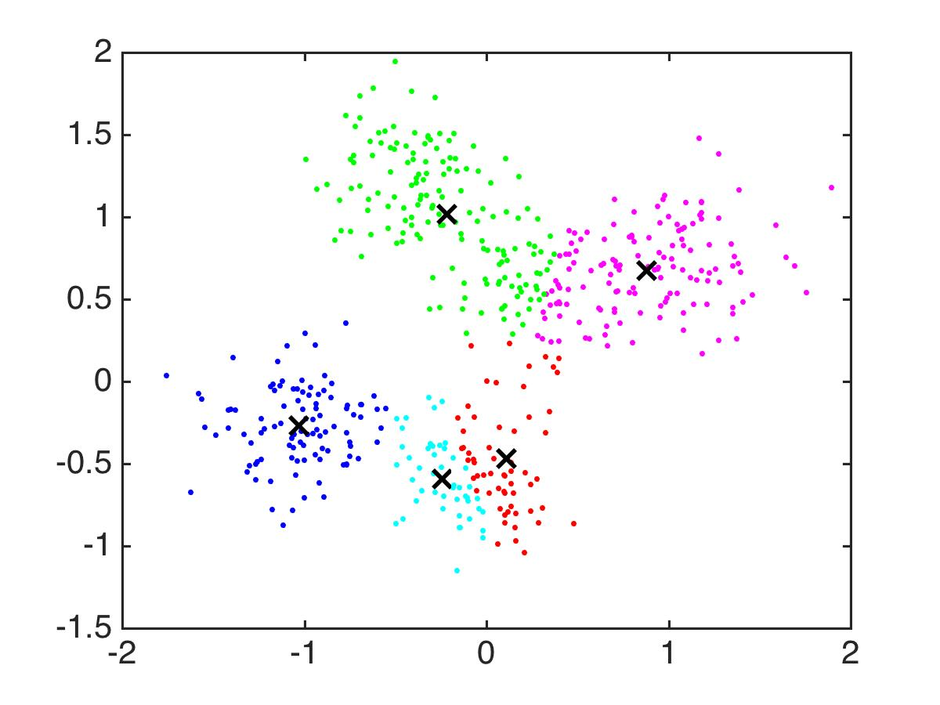

Slide 100
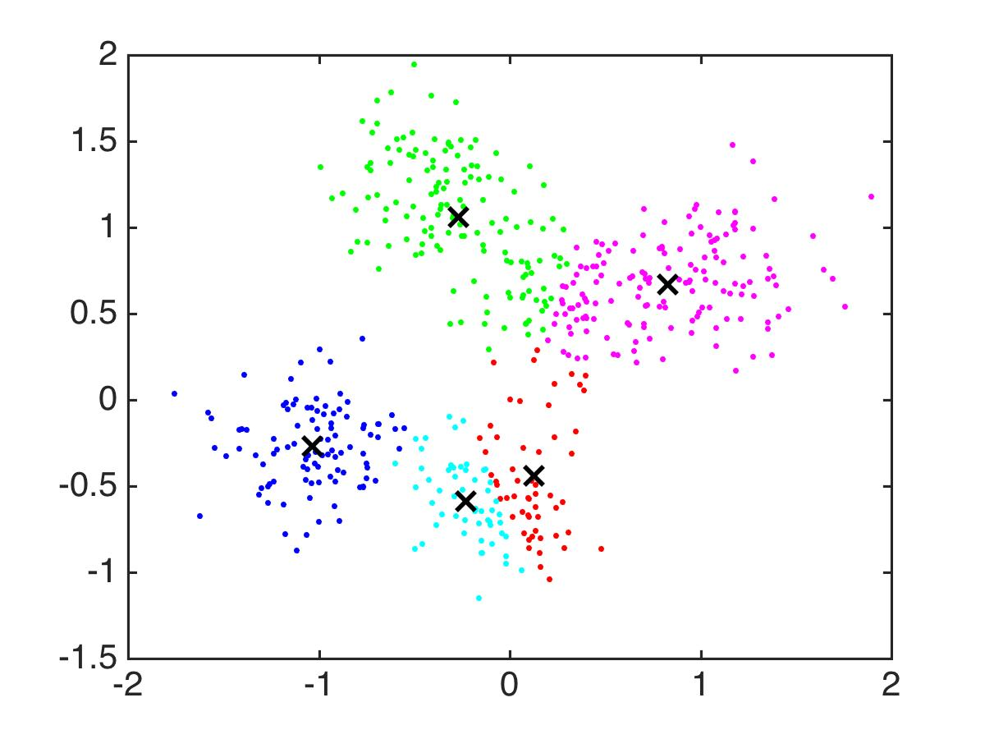

Slide 101
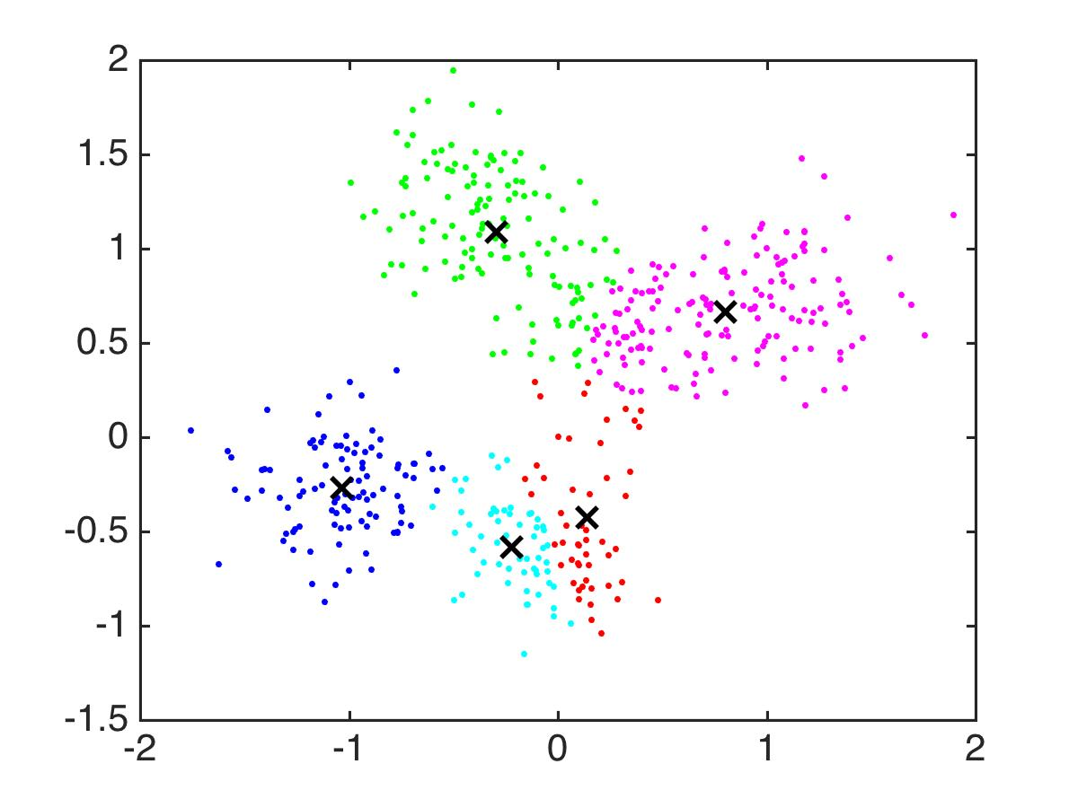

Slide 102
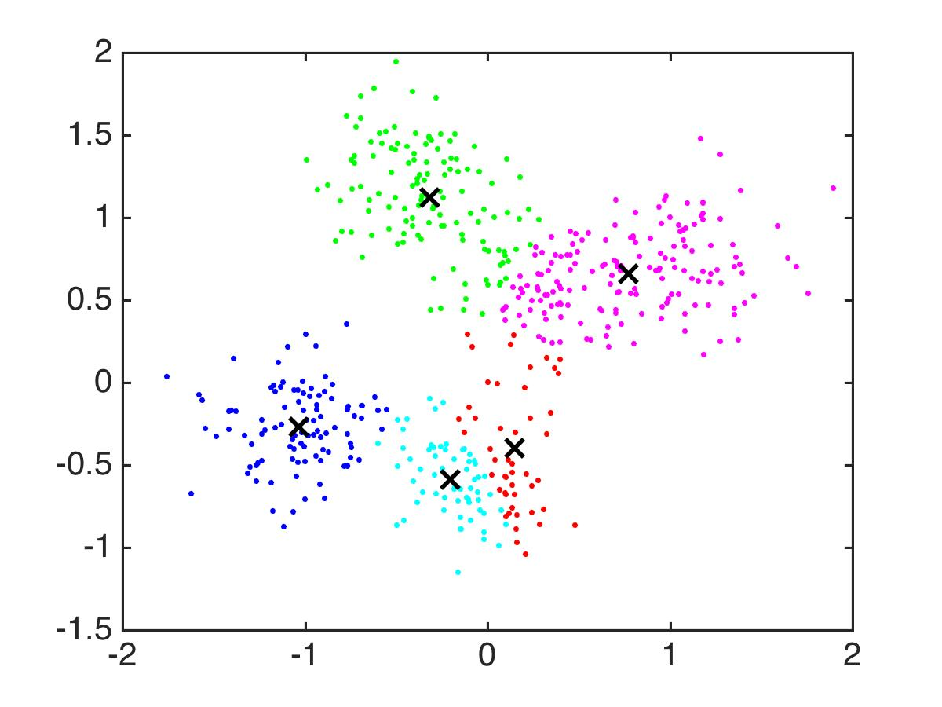

Slide 103
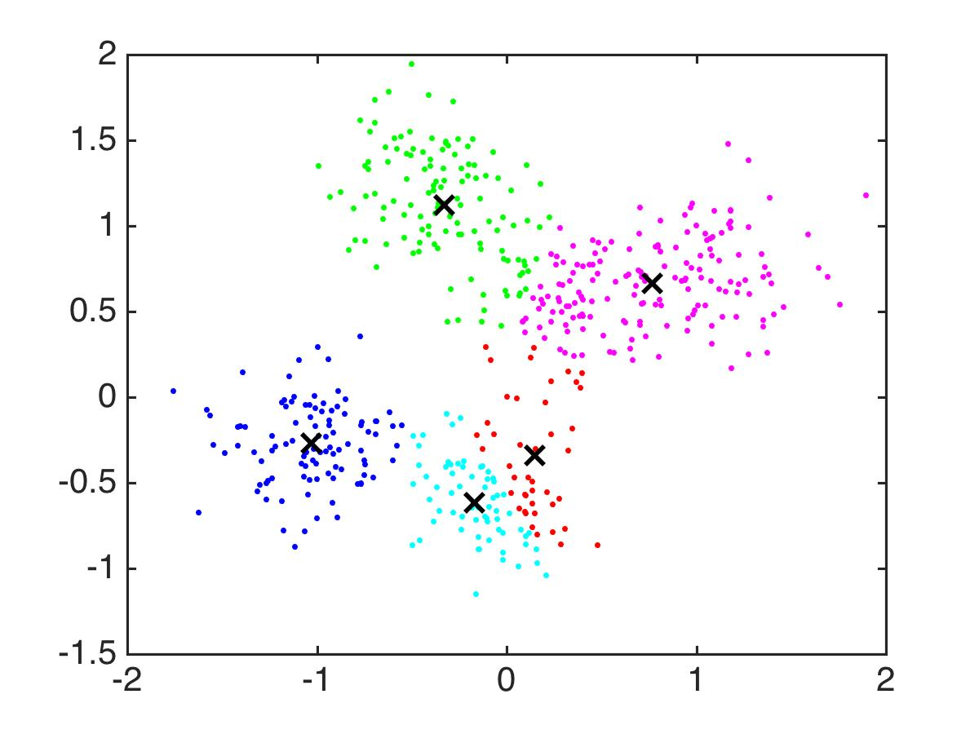

Slide 104
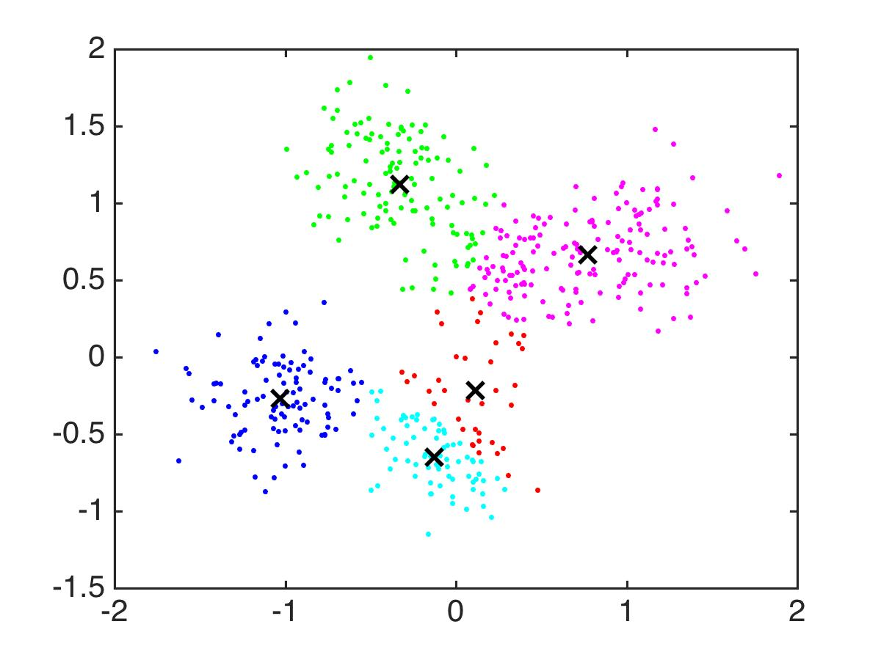

Slide 105
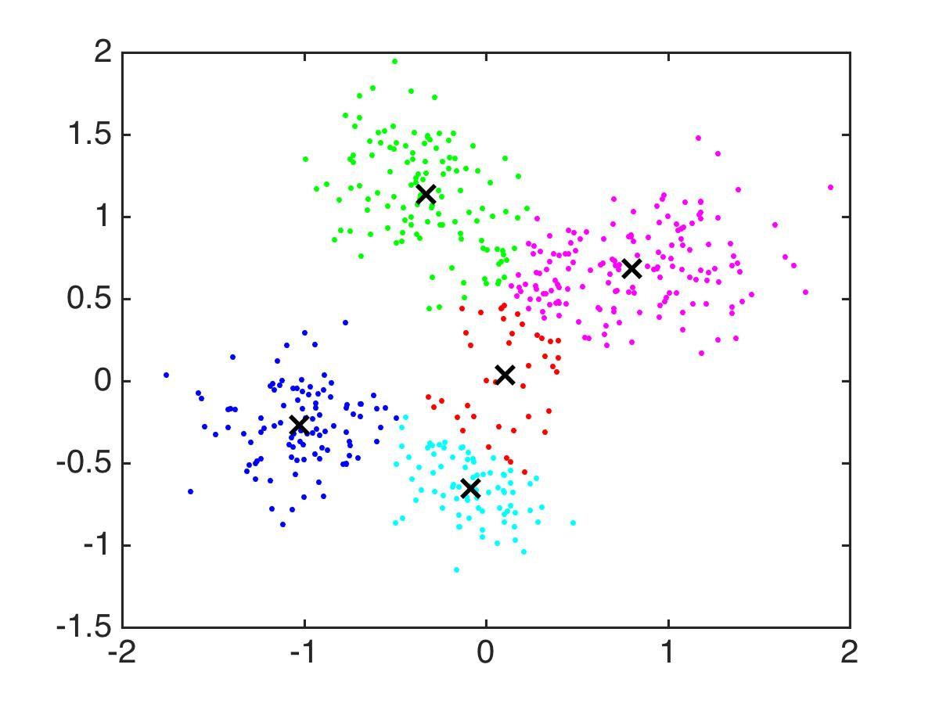

Slide 106


Slide 107


Slide 108


Slide 109


Slide 110


Slide 111


Slide 112


Slide 113

Notes:
STOP

Slide 114
Objetivo del K-Means
Input: Data set x₁,…,x_{n}, number of clusters K
Output: Cluster centers c₁,..,c_{K}
Goal: Minimize
Notes:
It would be really nice if we could just plain globally optimize this. Why the heck not?

Slide 115
Recomendadores
The Netflix contest: Build a better recommender system from Netflix data
Dark Knight
Alien
Bug’s Life
Cars
Carmen
Joseph
Leonore
Esmerelda
Use the crowd’s votes to complete the missing entries

Slide 116
Opción 1: User-Based Collaborative Filtering
Llenar el puntuación de Carmen’s para Alien usando puntaciones de usuarios similares
Dark Knight
Alien
Bug’s Life
Cars
Carmen
Joseph
Leonore
Esmerelda
Notes:
Who is similar to Carmen? Possibly Joseph. Definitely not Leonore. Need a measure to find similar users.

Slide 117
User-Based Collaborative Filtering & Correlation
where sim is:
Notes:
Here’s that. But I’m going to break it down a bit. I’ll put the whole thing back up in a minute.
The sum over movies is just movies that both people have rated. One problem with this measure is it tends to favor users who have watched very few movies that overlap with Carmen but that agree with her on the movies they watched.

Slide 118
User-Based Collaborative Filtering & Correlation
Beneficios: Fácil
Desventajas: Si hay muchos usuarios y películas, y no muchos usuarios han valorado de cada película, las similaridades no serán precisas, los estimadors serán pobres.
No toma en cuenta cuán similares son los items.

Slide 119
Opción 2: Item-Based Collaborative Filtering
Llenar la puntuación de Joseph para Dark Knight usando items similares
Dark Knight
Alien
Bug’s Life
Cars
Carmen
Joseph
Leonore
Esmerelda
Notes:
And so again, you would use correlations to weight the previous recommendations by how similar an item is to past ones. This can be pretty similar to the user-based collaborative filtering, so I won’t repeat the formula.

Slide 120
Item-Based Collaborative Filtering & Correlation
Beneficios: Fácil, supuestamente en la práctica las similaridades item-item son más robustas que las de usaurio-usuario
Desventajas: Puede haber estimaciones pobres para items impopulares
No toma en cuenta cuán similares pueden ser los usuarios para un item.

Slide 121
Matrix Factorization
Aliens
Dark Knight
Bug’s Life
Cars
Carmen
Scary
Kiddy
Scary
Kiddy
Carmen¹
Dark Knight
My guess for Carmen’s rating on Dark Knight:
Notes:
Let’s put her actual ratings up that we had before and you can see that our guess agreed with how she actually rated it, which means that our values for Carmen1 might be pretty accurate. The nice thing is that if you have carmen1, then you can sort of figure out how Carmen is going to rate a lot of different movies, as long as you know whether they are scary or kiddy movies.

Slide 122
Matrix Factorization
Descifra el espacio latente
Cómo representar cada usuario en el espacio
Cómo representar cada película en el espacio
Notes:
Matrix factorization figures out the latent factors. If the latent factors are really good, then we’re golden. That way, there can be very few latent factors and we can still recover ratings that are a pretty good approximations of the real ratings even though there might be thousands of movies. *talk about netlfix, when people realized matrix factorization techniques worked really well here”.
If you have a new movie that the user hasn’t seen before, as long as you know the latent state of the movie and the latent state of the user, you can guess.

Slide 123
Customer ➔ Latent
Latent ➔ Movies
Customer ➔ Movies
Jurassic Park
Dark Knight
Carmen
Leonore
P
Q^{T}
Joseph

Slide 124
Matrix Factorization
The model:
How to choose P and Q^{T}?
to minimize
Notes:
http://www.quuxlabs.com/blog/2010/09/matrix-factorization-a-simple-tutorial-and-implementation-in-python/

Slide 125
Matrix Factorization
Key strategy in winning Netflix Prize competition.
Notes:
Although the winning entry was quite a bit more complicated than matrix factorization. I got a chance to hear a talk by one of the winners of that competition and it was really cool. I wasn’t sure what to expect when I heard that talk, I thought it was going to be a lot of complicated technical trickery, but it wasn’t, it was really beautiful. These guys really looks hard at the data. This was the main thing that set them apart from the rest of the teams, these guys *knew* how people *behave* when they rate movies. They realized all sorts of interesting stuff, like that when people rate multiple products at once, their ratings change from when they are rating a single product at a time. So their model was absolutely laden with gems of sort of behavioral psychology of movie raters. It started with matrix factorization – just like what I’m describing – as the foundation, and then it took into account a lot of interesting ways in which people behave when they are rating products to adjust the predictions.

